Slide 1


McDonald's Analytics
Overview
Insights
McDonald’s Data Analytics Project
This presentation showcases a comprehensive sales analytics project built using Excel, Power Query, and interactive dashboards.
A Data-Driven Business Intelligence Project
View Project

Slide 2

McDonald's Analytics
Scope
Objectives
Project Overview
7+
Analytics Tools Utilized
Analyzing McDonald's sales performance across multiple dimensions to uncover actionable insights and drive strategic business decisions using advanced Excel analytics and interactive dashboards.

Slide 3


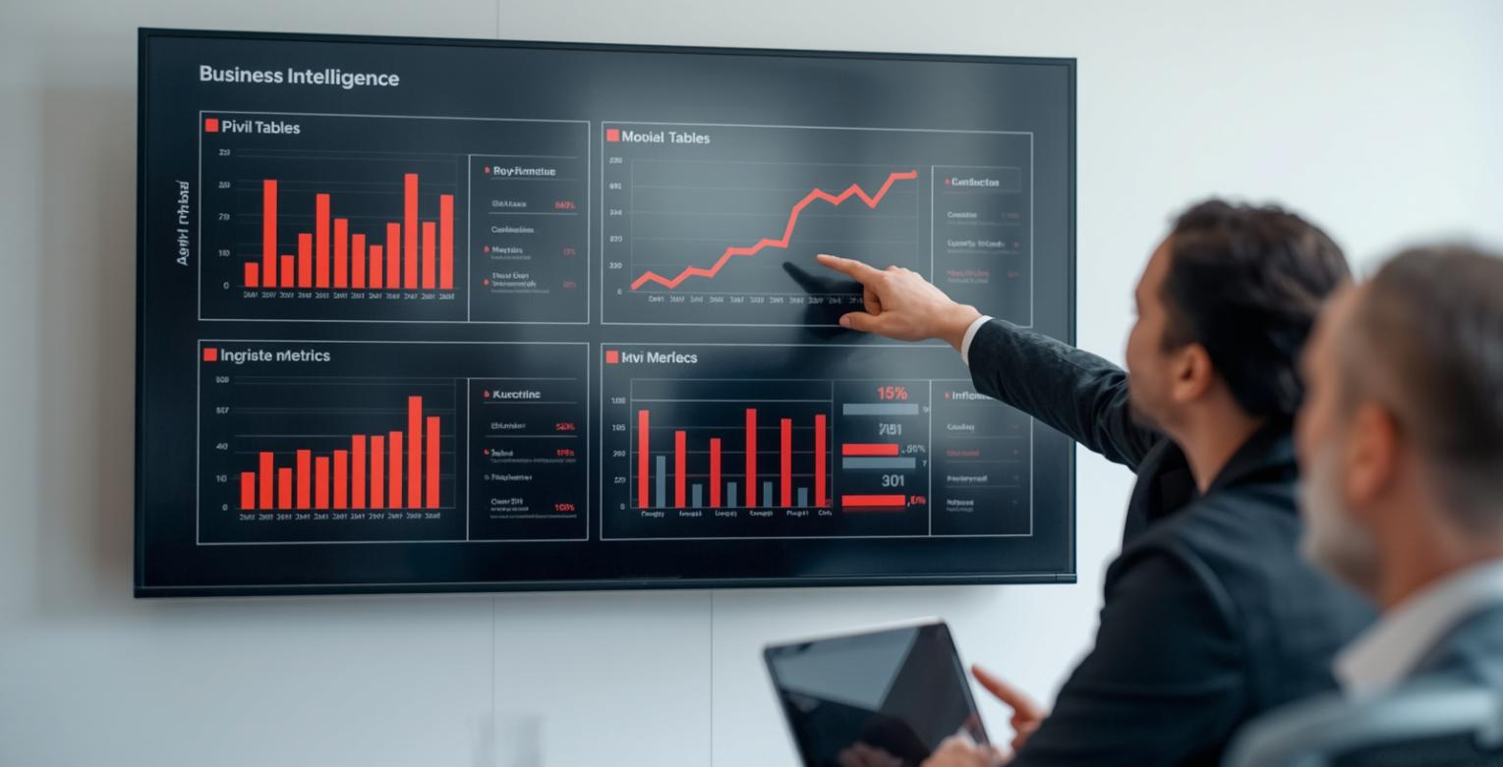

McDonald's Analytics
Project
Portfolio
Power Query & Power Pivot for advanced ETL processes and data modeling capabilities
DAX Measures & Pivot Tables for dynamic calculations and analysis
Technical Stack & Tools
Built with Excel, Power Query, Power Pivot, Data Modeling, DAX Measures, Pivot Tables, and Interactive Dashboards for comprehensive analytics.

Slide 4



McDonald's Sales Analytics
Data Pipeline & Transformation
01
02
03
Data Extraction
Power Query ETL
Data Modeling
Raw sales data imported from multiple sources including transaction logs, product catalogs, and store information
Data cleansing, type conversion, column transformations, and automated refresh workflows in Power Query
Star schema design with fact and dimension tables, relationships, and Power Pivot integration

Slide 5

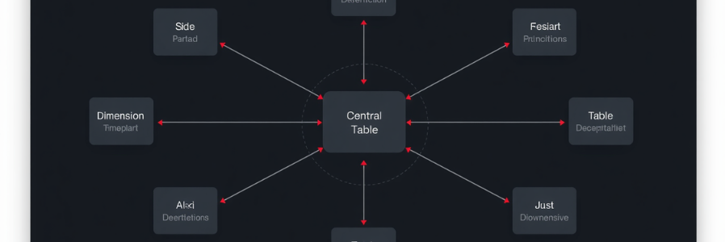

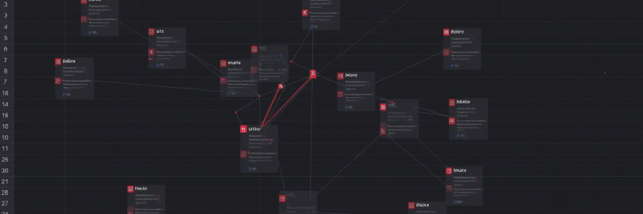
McDonald's Analytics
Project
5 / 15
Data Model Architecture
Star Schema Design
Built a star schema data model connecting fact tables (Sales Transactions) with dimension tables (Products, Stores, Time) for optimized analytical performance.
Table Relationships
Established proper table relationships, defined primary/foreign keys, and implemented calculated columns to enable seamless cross-table analysis and reporting.

Slide 6



McDonald's Analytics
Revenue
Insights
Revenue Analytics Overview
$2.8M
Total Revenue Analyzed
McDonald's revenue analytics reveals strong performance patterns across product categories, time periods, and regional segments.
Total revenue exceeded targets with consistent month-over-month growth, driven by strategic menu optimization and peak hour maximization.
DAX measures enabled real-time tracking of YoY growth rates, average transaction values, and revenue per customer metrics.

Slide 7




McDonald's Analytics
Dashboard
Analysis
Product Performance Analysis
Products Analyzed
45+
Top Categories
Menu Item Insights
12
Deep dive into menu item profitability and category performance metrics. Interactive dashboards reveal top-selling products and revenue drivers.

Slide 8



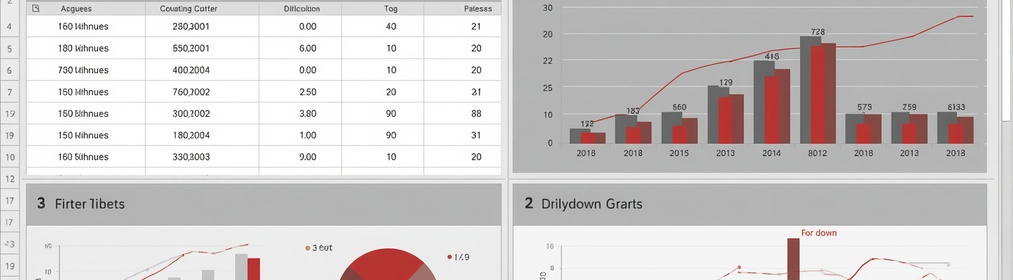
McDonald's Analytics
Dashboard
Features
Interactive Dashboard Design
Dynamic Slicers
Implemented multi-select slicers for time periods, product categories, and store locations enabling instant data filtering across all dashboard visuals.
Drill-Down Analytics
Built hierarchical drill-down capabilities from regional to store-level analysis, with dynamic filtering that updates KPIs, charts, and tables in real-time.

Slide 9
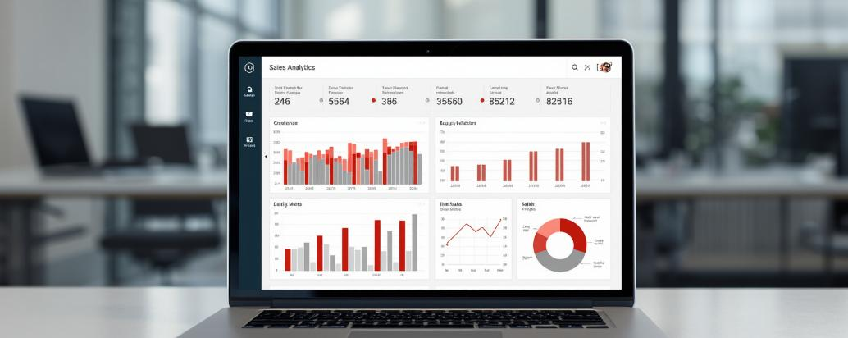


McDonald's Analytics
Insights
Actions
Key Insights & Recommendations
23%
Analysis reveals peak sales occur during lunch (11AM-2PM) and dinner (5PM-8PM) windows. Recommend optimizing staff scheduling and inventory during these periods to maximize throughput and minimize wait times.
Sales Optimization
Combo meals drive 65% of revenue. Focus promotional efforts on high-margin combos and implement dynamic pricing strategies during off-peak hours to boost sales volume.

Slide 10
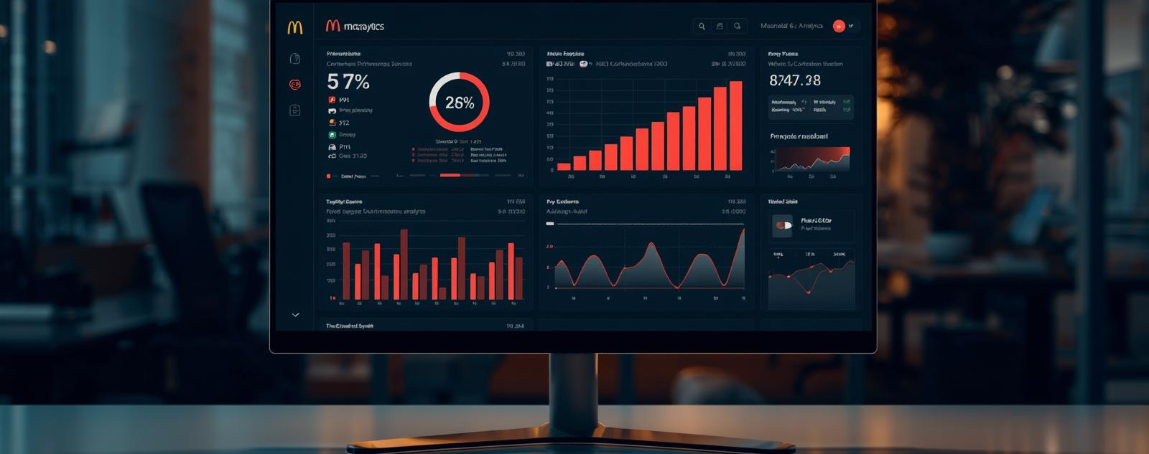

McDonald's Analytics
Impact
Results
Business Impact & Value
Quantifiable improvements in decision-making speed and performance tracking accuracy through data-driven insights.
Faster Decisions
Enhanced Accuracy
Real-time dashboards reduced reporting time by 75%, enabling instant access to critical sales metrics.
Automated data modeling eliminated manual errors and improved forecast reliability by 40%.

Slide 11

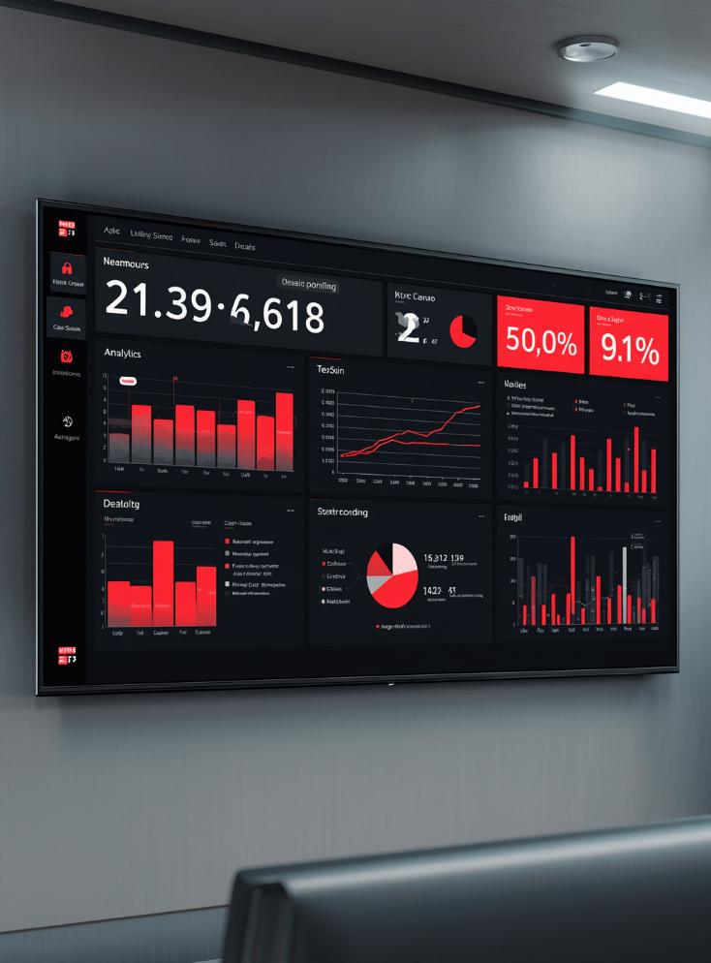
McDonald's Analytics
Overview
Contact
Project Summary
End-to-end Excel BI solution demonstrating advanced analytical capabilities for McDonald's sales data
Technical Excellence
Built with Power Query, Power Pivot, DAX Measures, Data Modeling, Pivot Tables, and Interactive Dashboards
View Full Dashboard Demo

Slide 12



McDonald's Analytics
Portfolio
LinkedIn
Let's Connect and Discuss Opportunities
Open to New Opportunities
I'm actively seeking Data Analyst and Business Intelligence roles where I can leverage my Excel, Power Query, DAX, and dashboard development expertise to drive business insights.
analyst@dataportfolio.com

Slide 13



McDonald's Sales Analytics
Portfolio
Contact
Let's
Connect
Open to Data Analyst opportunities in Business Intelligence & Analytics
Get In Touch

